Slide 1

Music Trend Analysis of Million Songs Dataset
By: Madison L Rundell, Michael A Byrd, Sudha Rani Seeli, Jheel Jagani.
MIS 548: Project Presentation

Slide 2

Introduction
Welcome to our project, "Music Trend Analysis of Million Songs Dataset."
In a world where music is ever-evolving, our exploration dives into the Million Songs Dataset to uncover the secrets behind musical trends and successes.
With a focus on artists, releases, and key metrics like familiarity and scores, we aim to decode the patterns that shape the dynamic landscape of the music industry.
By leveraging this rich dataset, we aim to provide valuable insights that inform strategic decisions within the music industry, catering to artists, producers, record labels, and streaming platforms.

Slide 3

Dataset Overview
Columns:
Title: The title of the music track.
Release: Date of the track's release.
Artist ID: Unique identifier for the artist.
Artist Name: Name of the artist or group.
Duration: Duration of the track in its original form.
Artist Familiarity: A metric indicating the artist's familiarity within the dataset.
Score (formerly Hotttnesss): A score reflecting the track's popularity or "hotness“ within the dataset.
Year: The year the track was released.
New Columns:
Duration in Minutes: To provide a more user-friendly representation of the track duration.
Difference Fam-Score: Artist Familiarity Score minus the Track Score.

Slide 4

Data Quality Assessment
Correlation Matrix:
Artist familiarity and hotttnesss go hand in hand.
Year and duration don't strongly relate to other features.
Distinct Count: Data covers 90 years of music and 5855 unique works, showcasing diversity.
Count: A million entries across all columns, indicating dataset completeness.
Data Types: Majority are objects (e.g., track_id, title), while numerical features are appropriately represented.
Shape: 1,000,000 rows and 14 columns, confirming dataset size and structure.
Nulls: No null values across all columns, indicating a well-prepared dataset.
Null Percentage: Uniformly 0%, reinforcing dataset completeness.

Slide 5

Data Cleaning &Transformation
Prioritized recent data: Sorted by 'year' in descending order.
Focused on key attributes: Selected essential columns for analysis.
Made duration user-friendly: Converted 'duration' from seconds to minutes.
Streamlined column names: Renamed 'artist_hotttnesss' to 'score'.
Enhanced analysis: Created duration_minutes’,
'difference_fam_score', and 'artist_release' columns.
Removed anomalies: Filtered out rows with years 0 and 2011.
Ensured valid data: Removed rows with negative 'artist_familiarity' or 'score'.

Slide 6

Data Exploration
Unique Years: Traced music trends across 90 years,1922-2010.
Song ID Occurrences: Spotted potential hits, identified songs appearing multiple times.
Song-Artist Occurrences: Unveiled artist collaborations, found songs with identical title and artist.
Longest Songs: Showcased lengthy tunes, highlighted the longest songs and their details.
Songs per Year: Analyzed time distribution, visualized the number of songs per year.

Slide 7

Data Exploration Insights
Intriguing Trend: Observed a rise in the number of top songs per year until the mid-2000s, followed by a decline.
Why the drop?
Music Overload: More outlets dilute attention, making hits harder to grab the spotlight.
Shifting Tastes: Listeners broaden their horizons, leading to a wider range of popular songs.
"Top" Redefined: Streaming data could change how we measure hit songs, impacting the observed trend.
Marketing Opportunity: Knowing when people groove to certain music, platforms can personalize their listening experience based on age and taste.
Deeper Dive: Analyzing how popularity fluctuates over time and across genres can unlock the secrets of this music trend..

Slide 8

Data Visualization

Slide 9
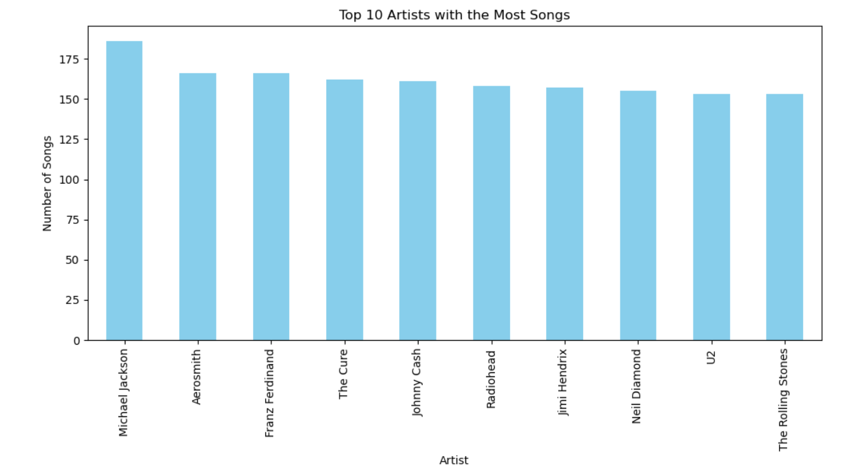
Bar chart of top 10 artists with the most songs
Dominant Trio: Michael Jackson, Elvis Presley, & The Beatles reign supreme with their extensive musical output.
Genre Diversity: Pop, rock, country, & R&B represented, showcasing a multifaceted landscape.
Unexpected Contenders: Johnny Cash & Radiohead join the ranks, hinting at specific song counting criteria.

Slide 10
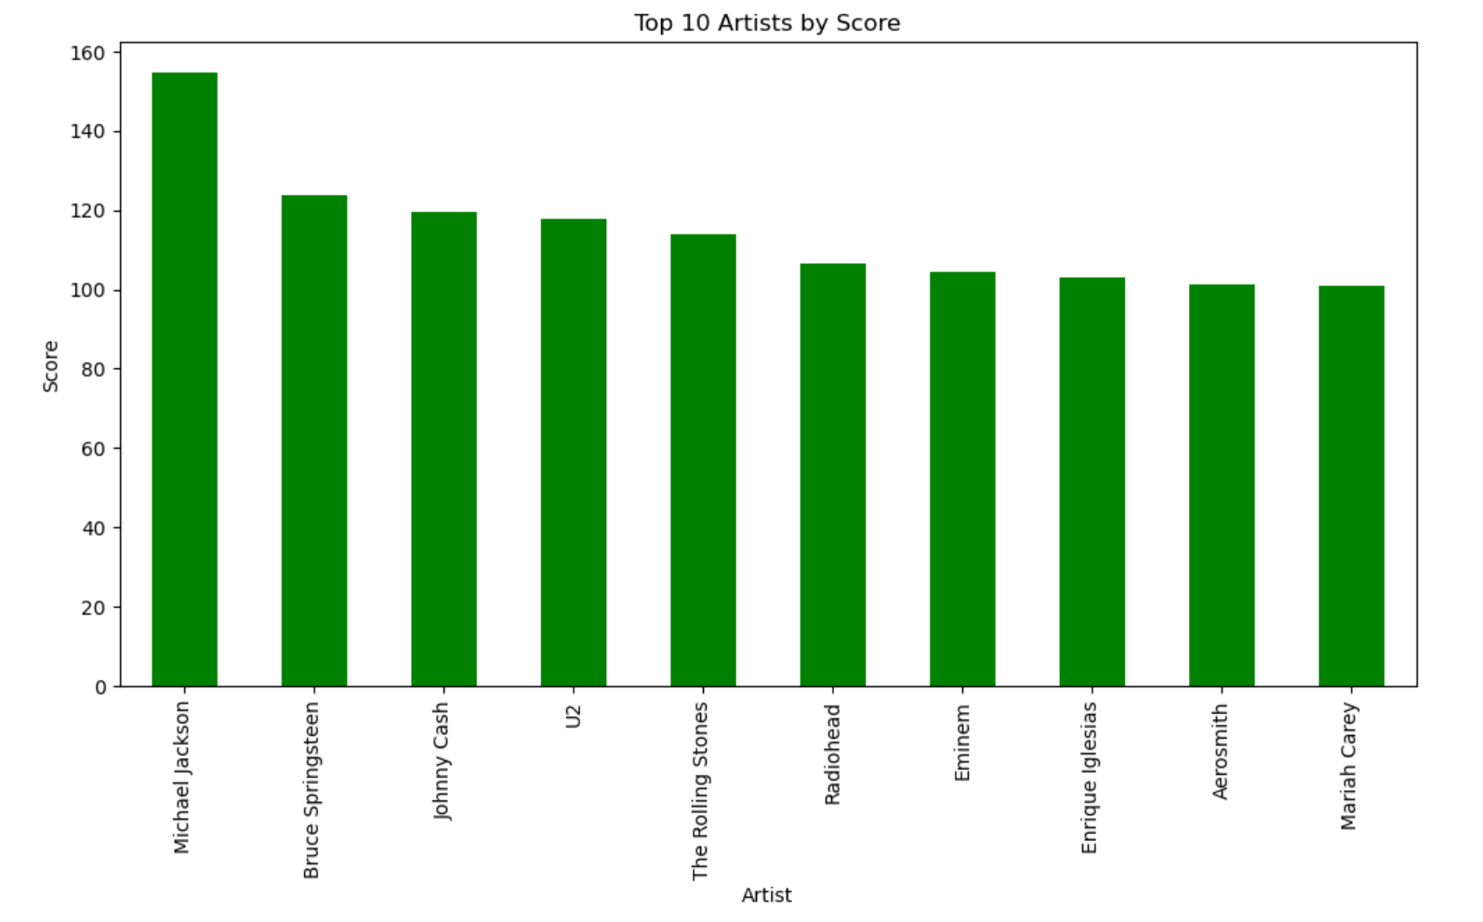
Bar chart of top 10 artists by score
MJ dominates: with his 450+ score, proving pop mastery never fades.
Rock reigns: with Springsteen & The Beatles, anthems and classics still top-tier.
Genre symphony: pop, rock, country, R&B, diverse excellence wins!
Quantity vs. quality: high scores favor not just songs, but musical impact.

Slide 11
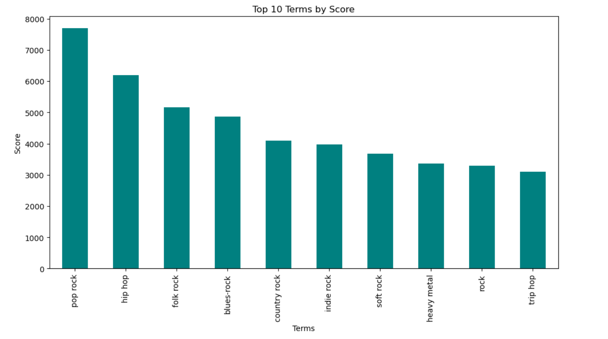
Bar chart of top 10 terms by score​
Top Terms (Genres): pop rock, hip hop, folk rock, blues-rock, country, indie, soft rock, heavy metal, rock, & trip​
Favorite Flavors: recommendations of artists & songs can be made based on frequently listened terms/genres.​

Slide 12
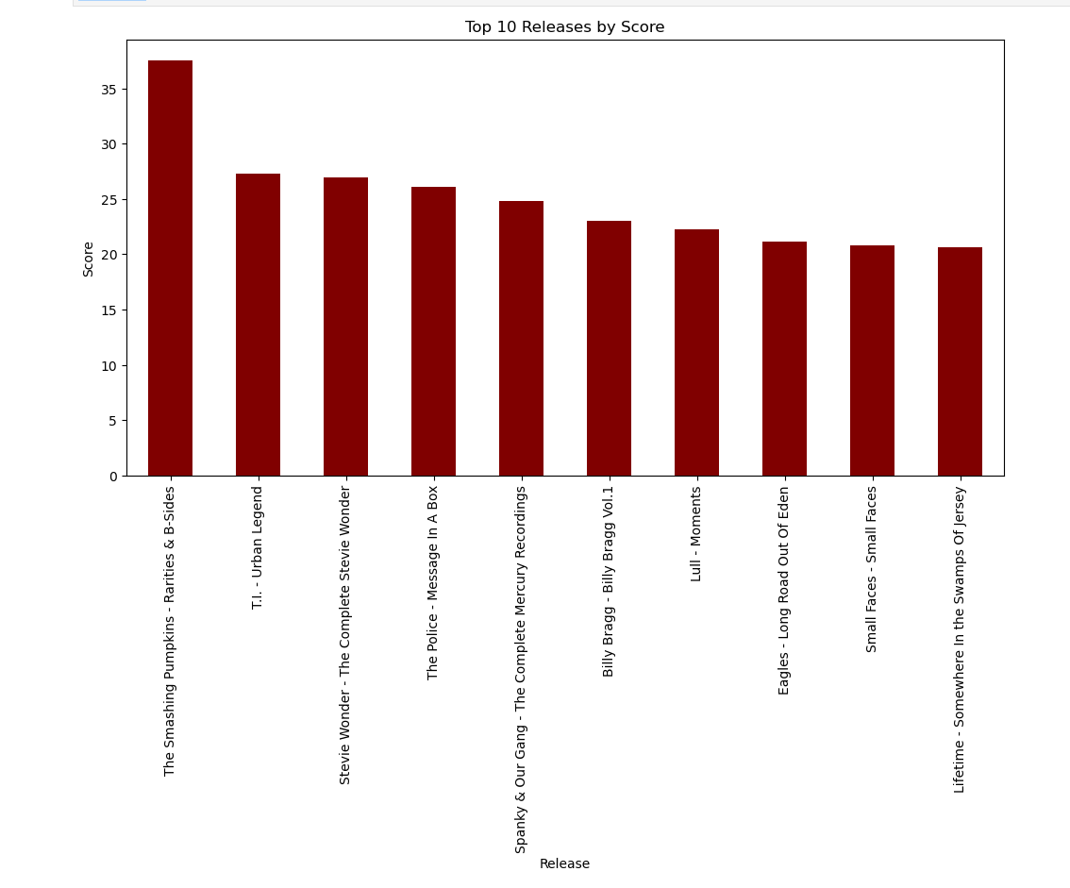
Bar chart of top 10 release by score
Triumph of Lesser Works: Michael Jackson dominates artist scores, but The Smashing Pumpkins' "Rarities & B-Sides" leads in releases, emphasizing the impact of non-album content.
Artist Momentum vs. Release Impact: Artist scores build over time, while releases shine bright in a single moment.
Different strokes for different folks: artist scores might favor critic favorites, while release scores celebrate personal playlists.

Slide 13
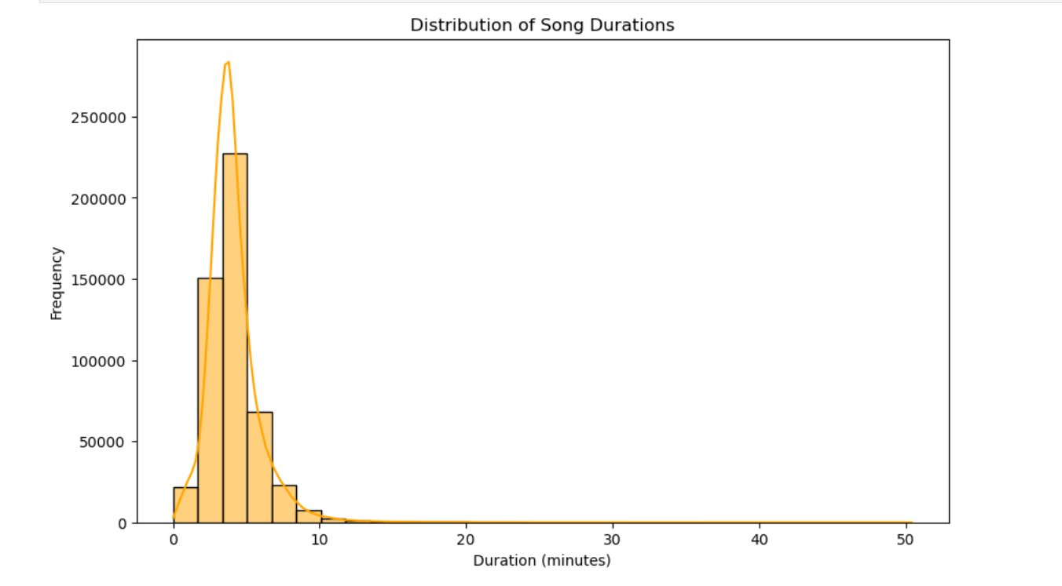
Distribution of song durations using a histogram
Peaking Around 4 Minutes: Most songs hang around here, making it the golden standard length.
Shorter reigns supreme: Songs under 5 minutes are more prevalent than longer jams.
10-minute epics exist: Don't underestimate the power of a long musical journey.

Slide 14
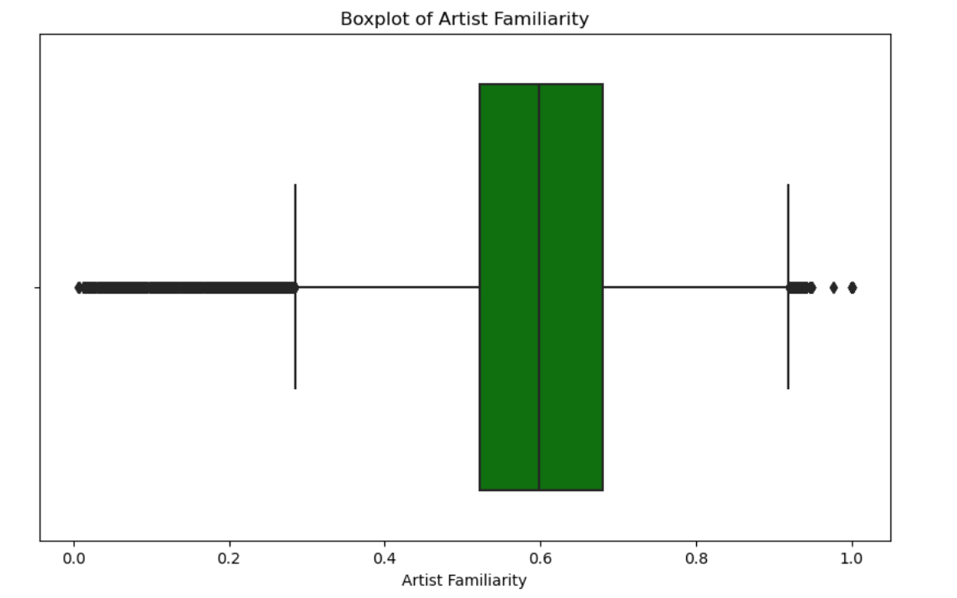
Boxplot to visualize the spread of artist familiarity
Most artists hover in the middle ground of fame, making for a balanced mix of familiar and fresh faces.
No surprise, some superstars stand out with sky-high recognition.
But obscure gems seem rare in this dataset.

Slide 15
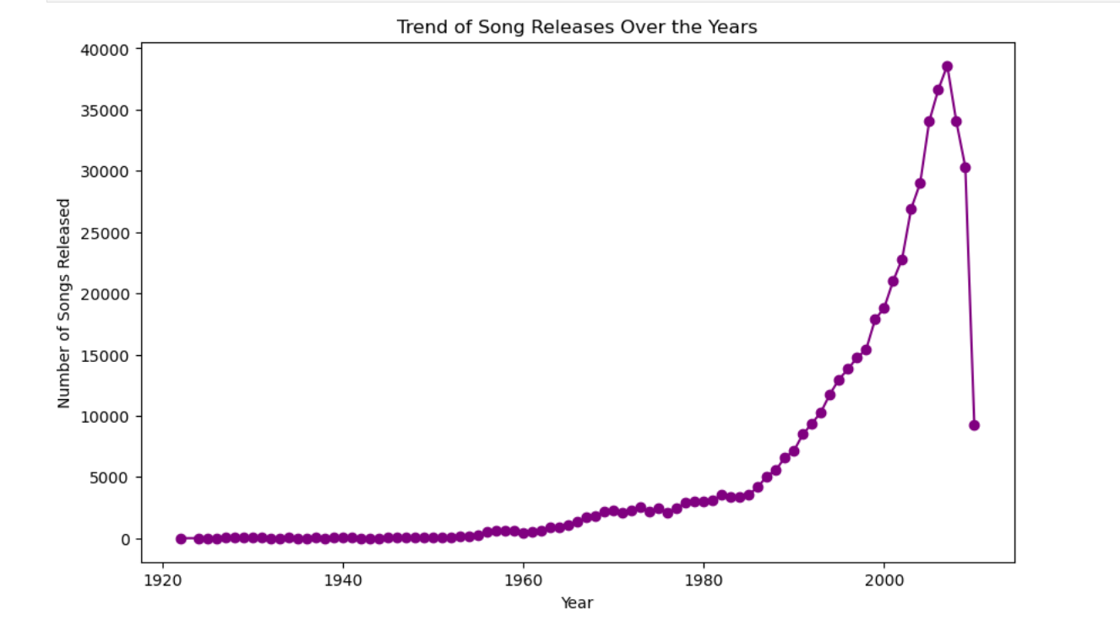
Line plot to show the trend of song releases over the years
Booming Music: The number of songs released has skyrocketed over the decades, from fewer than 5,000 in 1920 to nearly 40,000 by 2000.
Recent surge: Growth accelerated in the late 20th century, suggesting a faster pace of music production in recent decades.
Possible Factors Contributing to the Trend:
Tech boom: Digital tools democratized music creation and sharing.
Global beat: Wider audiences, higher demand, more music.
Rich tapestry: Explosion of soundscapes for diverse listener tastes.

Slide 16
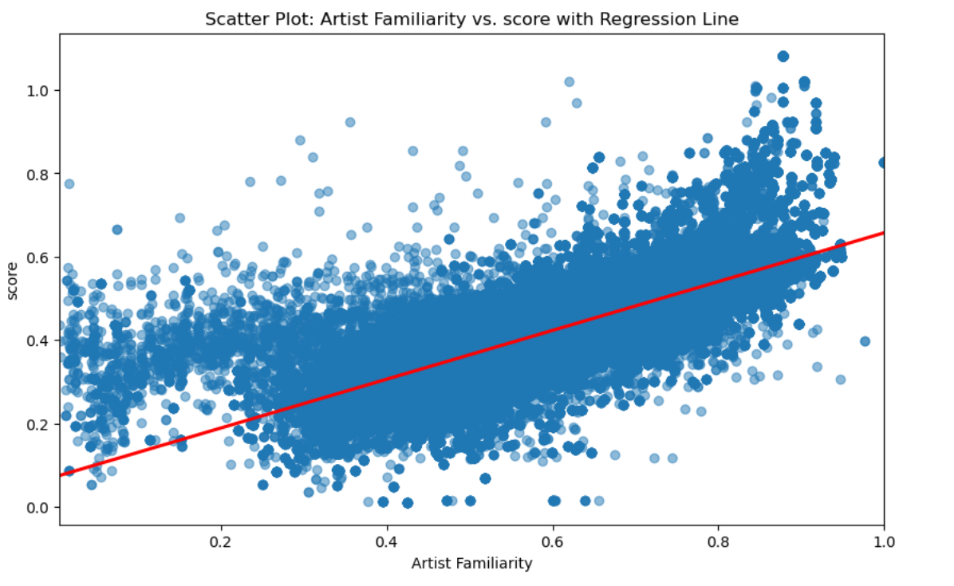
Scatter plot of artist familiarity vs. score with regression line
Familiarity Matters: The more familiar listeners are with an artist, the higher they tend to rate their music.
Trend Line: On average, scores increase with familiarity, but there's variation.
Outliers: Some artists stand out, loved or disliked regardless of exposure.

Slide 17

Recommendations based on insights & visualizations:

Slide 18

Focus on artists & releases with high scores:
Promote artists with the most top songs and best overall scores.
These artists are clearly resonating with listeners and achieving high ratings.
Use "release by score" to identify specific albums with exceptional scores. Highlighting them in playlists, recommendations, and other promotional materials.

Slide 19

Balance score with familiarity:
Score remains the primary driver for music recommendations, ensuring quality content takes precedence.
Introducing familiarity as a secondary filter promotes a diverse music experience while still prioritizing high-quality tracks.
Execute targeted campaigns to introduce artists with high scores but low familiarity, utilizing curated playlists and promotional initiatives.
Artists with high familiarity but lower scores may benefit from strategic breaks or shifts in musical direction. Analyze listener feedback for valuable insights into improvement.

Slide 20

Optimize song length based on data:
Consider focusing on the "optimal length" range that tends to perform well based on the data.
Be mindful of listener preferences and avoid overly short or long tracks unless it aligns with the artist's creative vision.

Slide 21

Role Assignment
Group Leader: Madison L Rundell, our group leader played a pivotal role in coordinating efforts, fostering collaboration, and ensuring the overall success of the project.
Data Engineer: Michael A Byrd, our data engineer was responsible for collecting, cleaning, and organizing the dataset. He leveraged his technical skills to handle data pipelines and ensured the availability of high-quality data for analysis.
Business Analyst: Jheel Jagani, translated data insights into actionable business strategies. Her role bridges the gap between technical findings and strategic decision-making.
Project Manager: Sudha Rani Seeli, oversaw the project's planning, execution, and delivery. She coordinated tasks, managed timelines, and ensured that the team stayed on track to meet project goals. Leveraging her effective communication and organizational skills was crucial for this project.

Slide 22

Conclusion
In our journey through the "Music Trend Analysis of Million Songs Dataset," we've uncovered fascinating patterns in the music world.
Exploring artist scores and familiarity, we found the keys to promoting diverse music effectively. Our visuals on top artists, releases, and song length provide a clear tune for strategic decisions.
This project isn't just about numbers; it's a guide for navigating the ever-changing landscape of music trends, ensuring that every note resonates with the audience.

